Slide 1


Capstone Project – AI-powered cash flow forecasting tool
Group 4
Lai Wing Man, Carmen
Law Tak Chun, Dirk
Keung Kwan Lam, Olivia
Ho Chun Kit, Philip
Chan Tung Wai, Teddy
Tang Chi Fung, Jacob
Notes:
AI-generated content may be incorrect. --- In this presentation, we will explore how machine learning techniques can be utilized to predict customer churn. We will analyze the project objectives, the dataset used, data preprocessing steps, feature engineering, the methodology employed, and the results derived from our analysis.

Slide 2

Agenda Items
Project Objectives
Dataset Overview
Data Preprocessing
EDA
Analysis and Discussion
AI ChatBot
Evaluation
Notes:
We will begin with the project objectives which outline the goals of our analysis. Then, we'll review the dataset, followed by the data preprocessing techniques. Next, we will discuss feature engineering and selection methods. The methodology section will detail the models used and evaluation strategies, and we will conclude with our results and evaluation.

Slide 3
Project Objectives
Notes:
The main goals of this project are to construct a classification model to predict customer churn and identify the key drivers influencing this behavior through feature importance analysis.

Slide 4

Objective
Objective
Zenith, a mid-sized financial consultancy, seeks to enhance client cash flow management through an AI-powered forecasting tool.
Goals
Gather historical financial data
Clean and normalize financial statements
Identify key cash flow indicators and patterns
Build regression models for revenue and expense prediction
Create sensitivity analysis capabilities for scenario testing
Design interactive visualizations of cash flow projections
Apply LLM to build an AI chatbot for question answering
Notes:
We aim to create a reliable classification model that can predict which customers are likely to churn. This model will enable the business to take proactive measures to retain customers.

Slide 5
Dataset Overview
Notes:
The dataset used for this project is sourced from the Kaggle Telco Customer Churn Dataset. It contains 7,043 customer records with 21 attributes that are crucial for our analysis.

Slide 6

Dataset Introduction
Source: EODHK via APIs
Description: Using Apple (US:AAPL) past 20 years
balance sheet
cash flow
income statement
Dataset includes: key financial metrics (revenue, net income, assets, cash flow, ratios) spanning multiple years
Data from various sources, with some missing values and anomalies
Time span: Starting from 1994 to present
Notes:
This dataset is publicly available on Kaggle and provides detailed information regarding customer demographics, account information, and service usage, which are essential for our churn prediction model.

Slide 7
Data Preprocessing
Notes:
Before building our model, we need to preprocess the data to ensure its quality and suitability. This includes handling missing values, encoding categorical variables, and normalizing numerical features.

Slide 8
Data Preprocessing
Datetime Conversion:
Converted 'date' column to datetime format with:
Filtering Data:
Included only data from 1994 onwards to focus on recent trends:
Indexing:
Set 'date' as index for time series analysis:
Descriptive Statistics in Billions:
Calculated key metrics’ stats and converted to billions for readability
Notes:
Managing missing data is critical. For example, the 'TotalCharges' feature may have missing entries, which we can handle by either imputing or removing these records.

Slide 9
EDA
Notes:
Before building our model, we need to preprocess the data to ensure its quality and suitability. This includes handling missing values, encoding categorical variables, and normalizing numerical features.

Slide 10
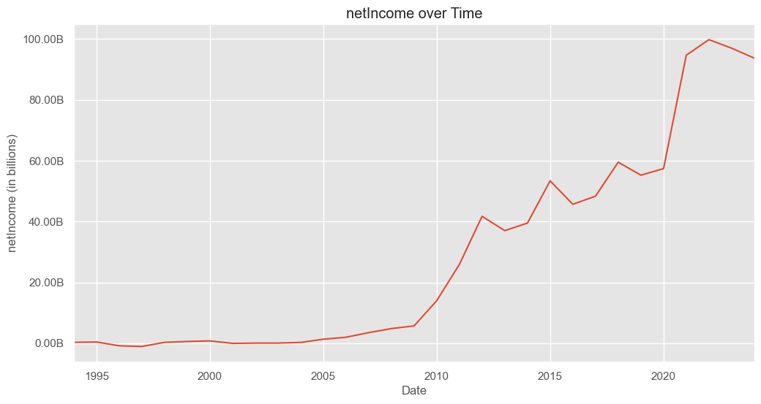
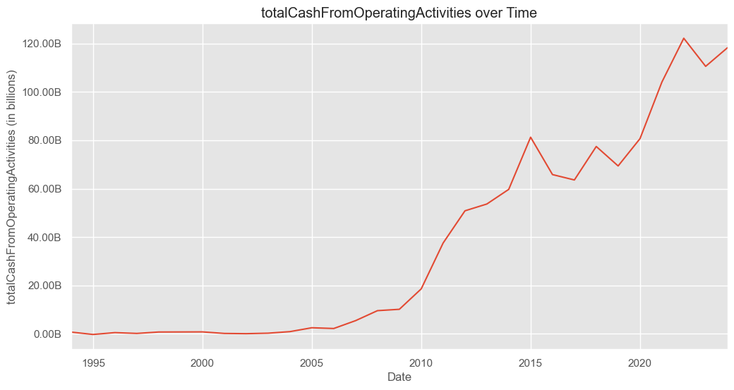
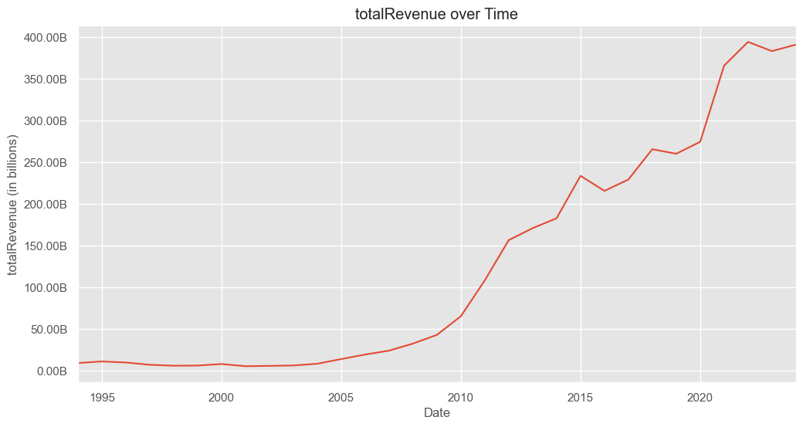
Time Series Visualization
Consistent upward trend in revenue and assets.
Growth accelerations linked to product launches.
Fluctuations during market events or strategic moves.

Slide 11
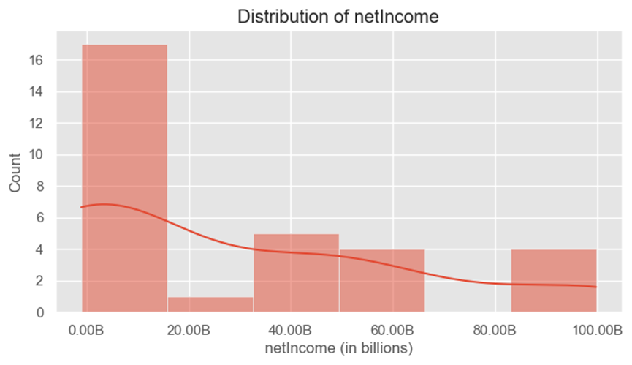
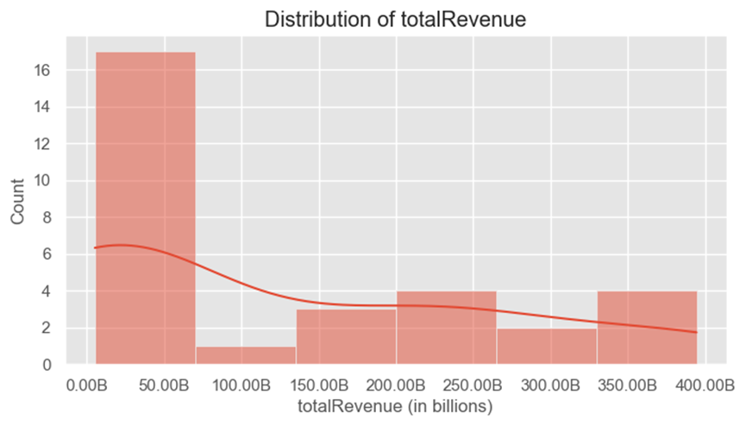
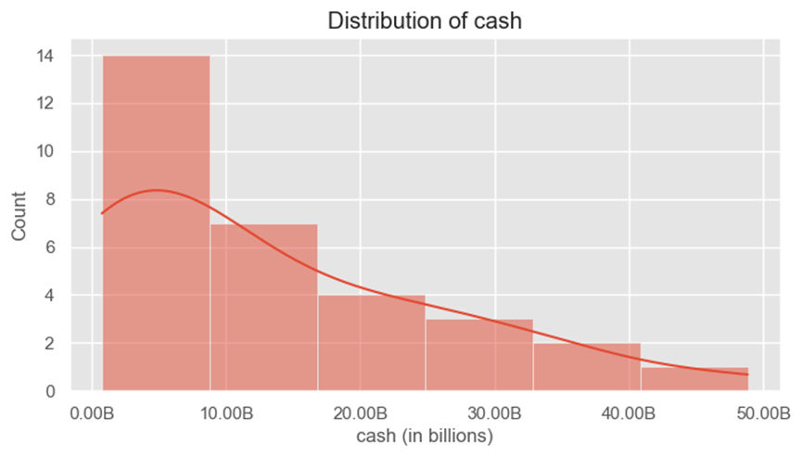
Distribution Analysis
Histograms and KDE plots for each key metric
Right-skewed distributions indicating high-value years
Presence of outliers representing exceptional performance or crises

Slide 12
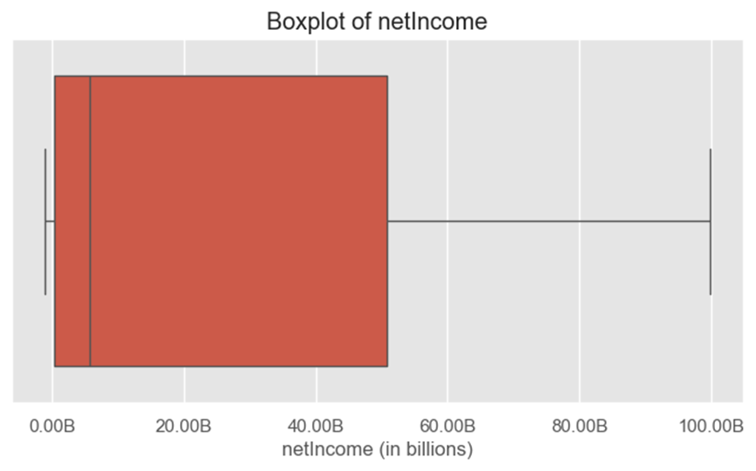
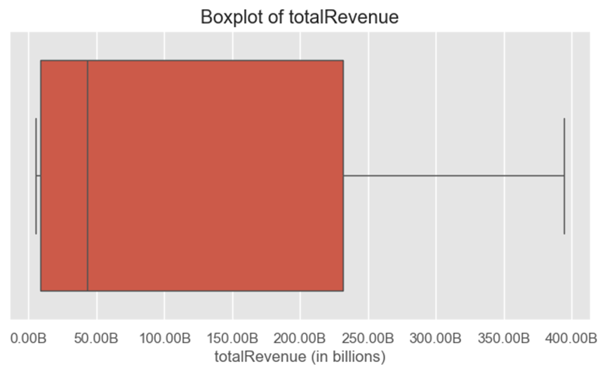
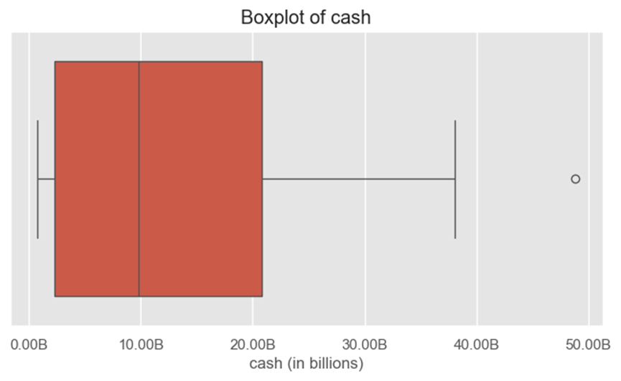
Outlier Detection
Boxplots for revenue, net income, cash
Years with record-breaking figures or downturns
Outliers often align with major events, warranting further analysis

Slide 13
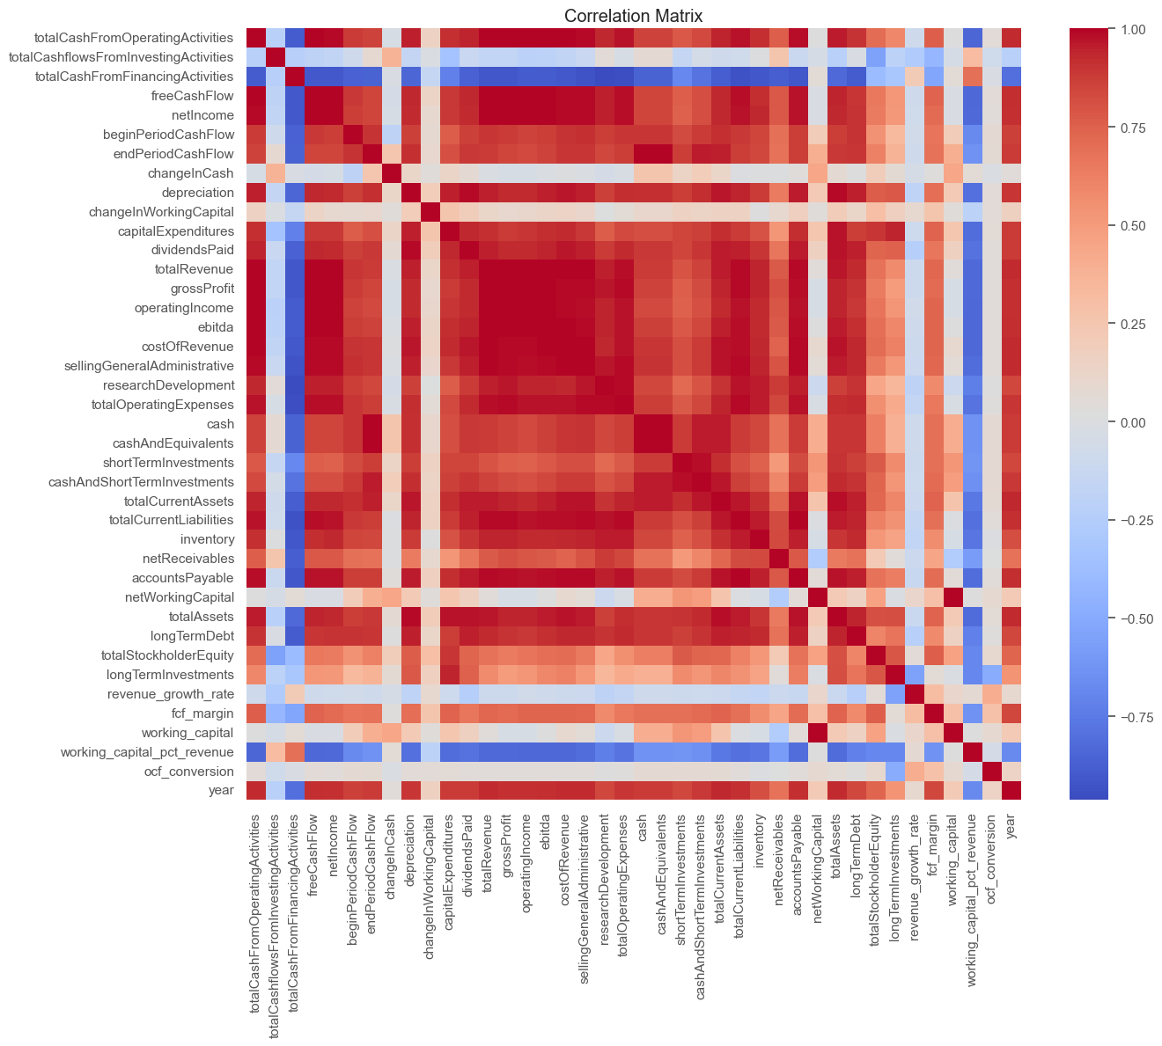
Correlation Matrix Heatmap
Heatmap showing correlations between metrics
Strong correlation between revenue & assets
Profitability and gross profit are highly linked
Liquidity (cash) moderately correlated with revenue

Slide 14
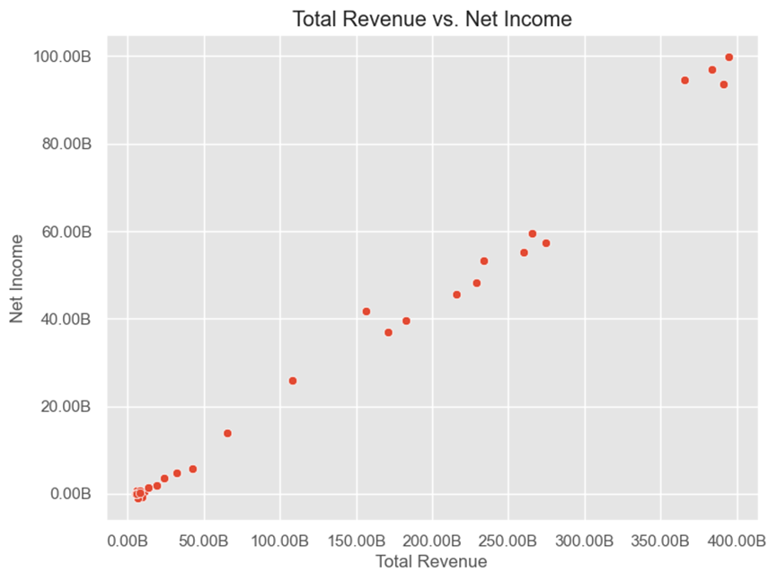
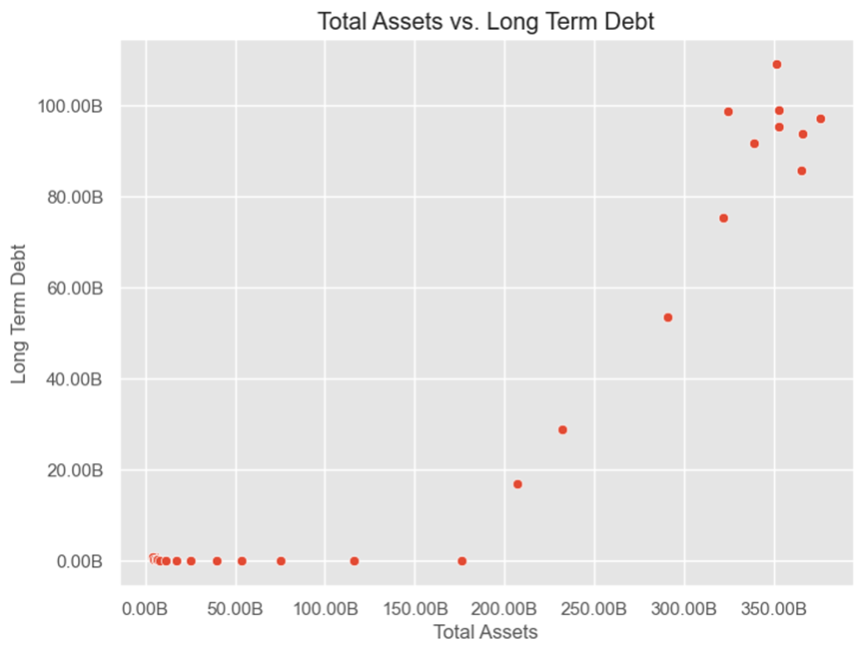
Scatter Plots of Key Relationships
Scatter plots
Revenue vs. Net Income
Assets vs. Long-term Debt
Positive linear relationship confirms financial theory
Outliers indicate unusual years needing detailed review

Slide 15
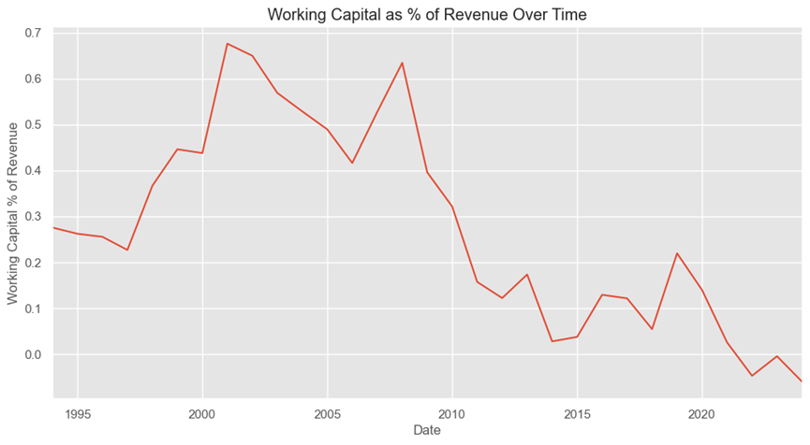
Ratios Over Time
Line graphs of profit margin, working capital ratio
The ratio has shown a downward trend over the years
Indicates potential improvement in operational efficiency or cost management
Could also suggest tightening liquidity or increased operational costs
Important to analyze whether this decline reflects healthy efficiency gains or potential liquidity issues
Monitoring this ratio helps assess financial health and operational effectiveness

Slide 16
Analysis and Discussion
Notes:
Our methodology involves selecting appropriate machine learning models, validating their performance, and optimizing model parameters to improve predictions.

Slide 17

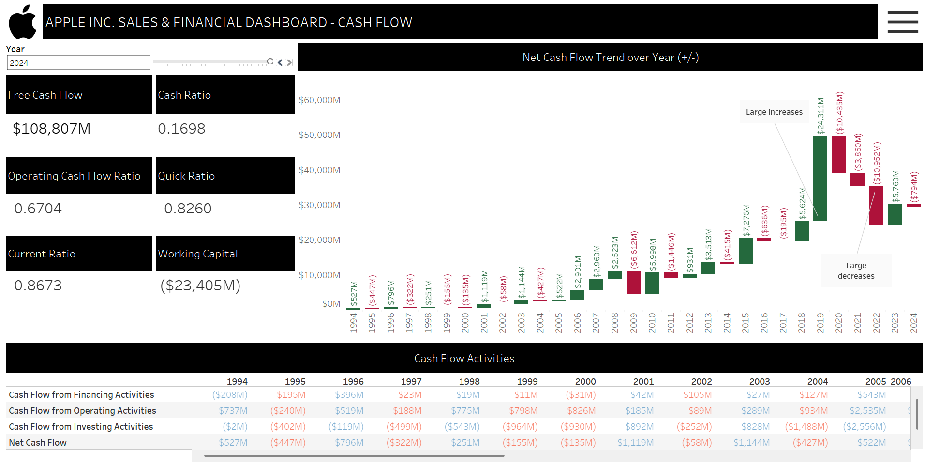
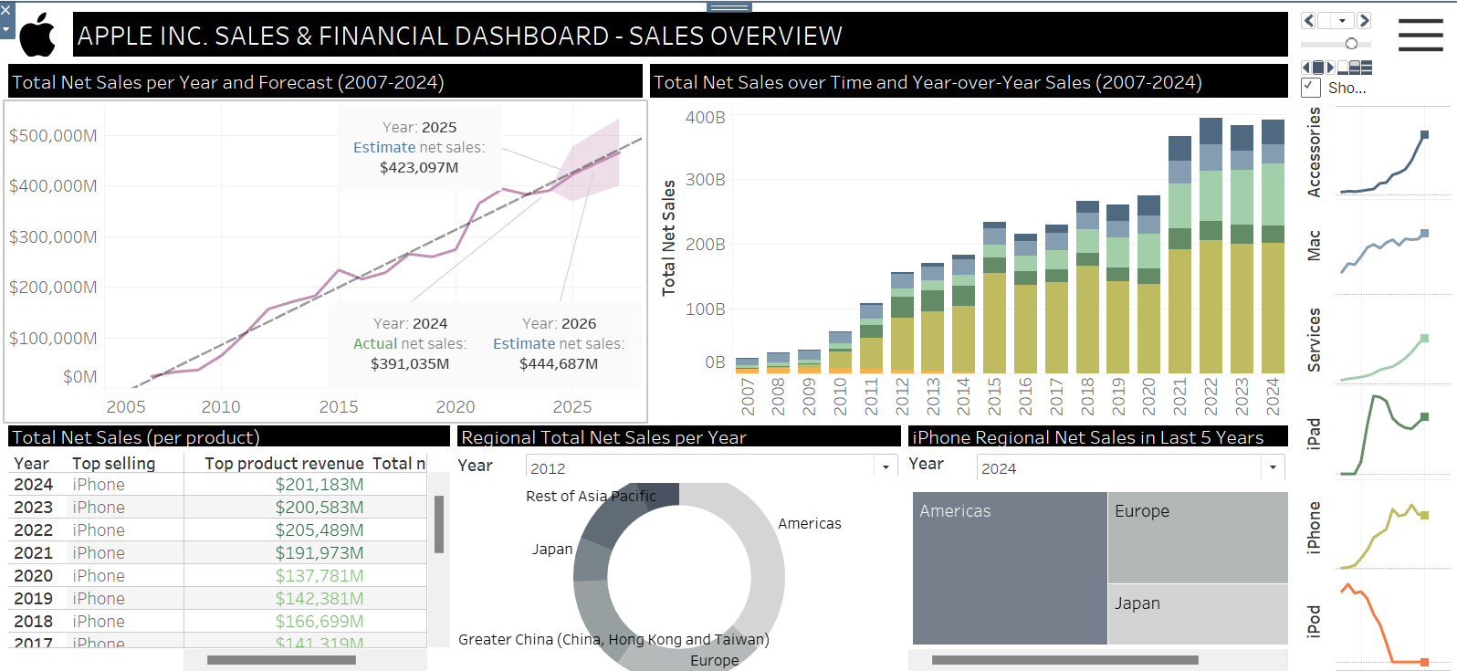
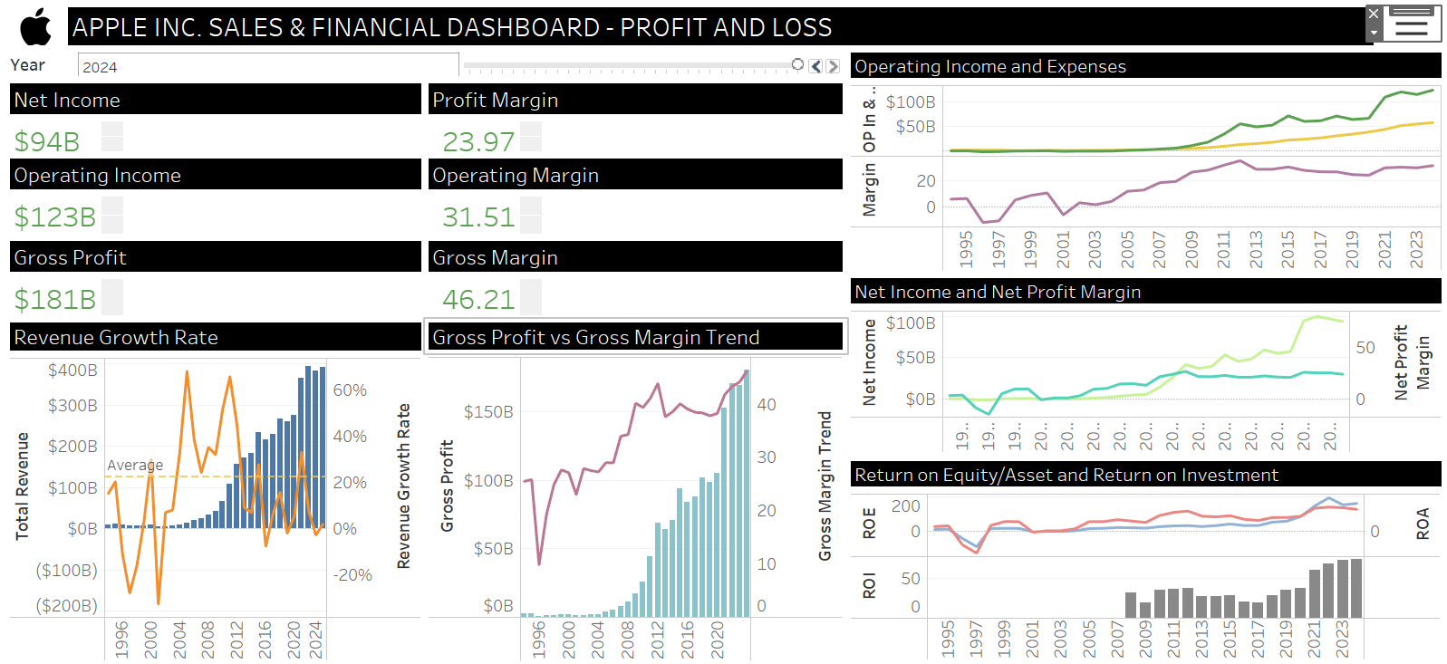
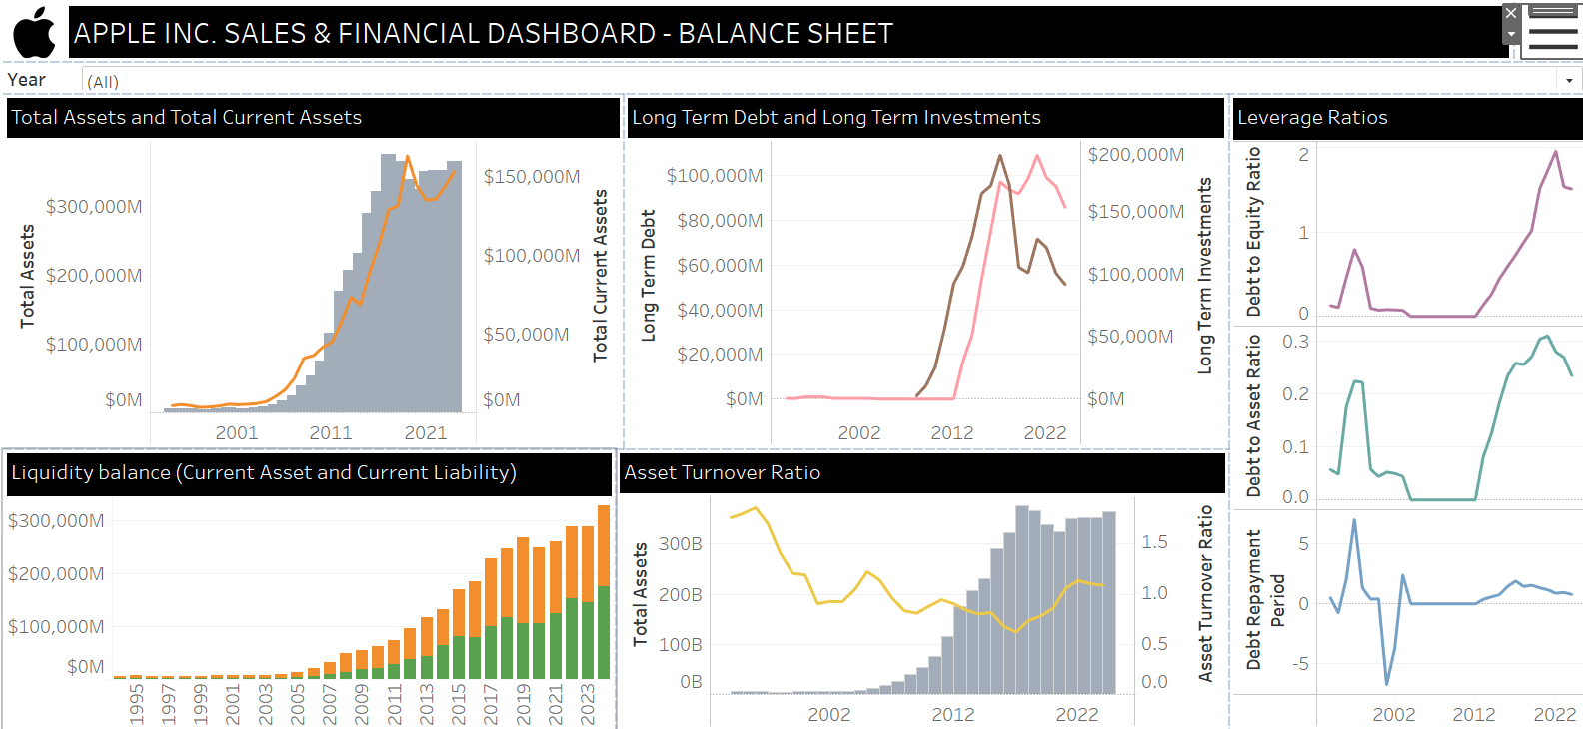
Data visualization
Please refer to the Tableau Dashboard for demonstration

Slide 18
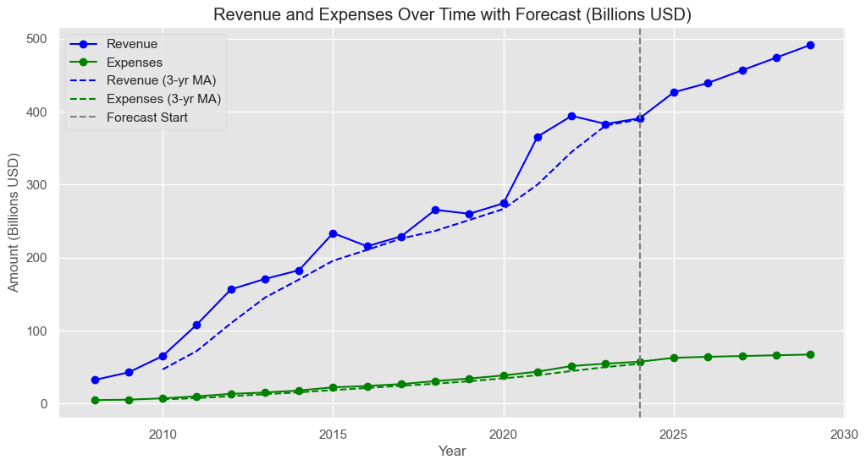
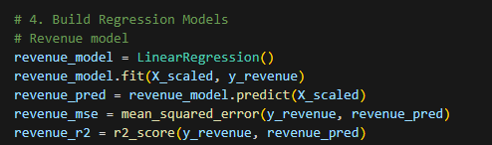
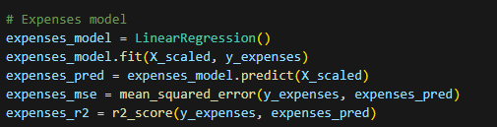
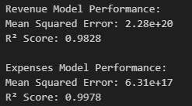
Model Development
Build up a Linear Regression Model

Slide 19
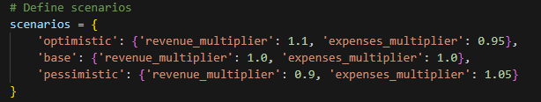
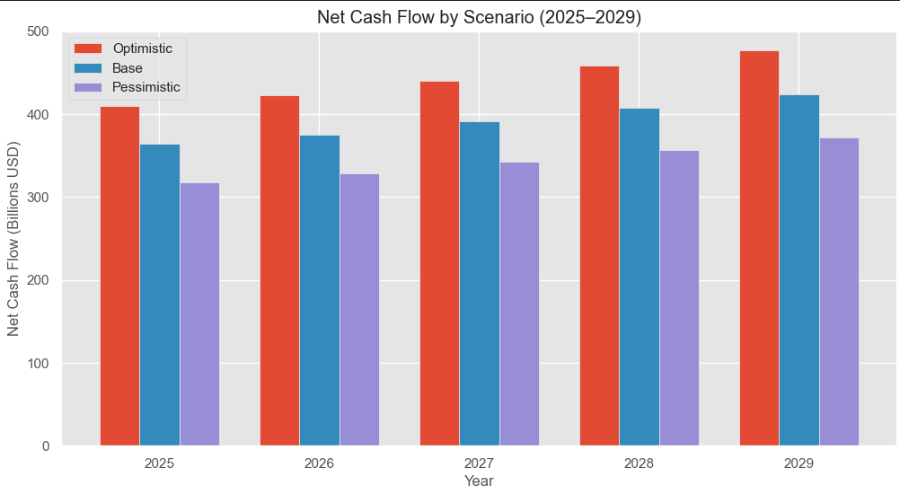
Model Development – Scenario Testing
 | Revenue | Expenses
Optimistic | Increase 10% | Decrease 5%
Basic | Remain unchanged
Pessimistic | Decrease 10% | Increase 5%

Slide 20
Liquidity Monitoring Dashboard
Notes:
Our methodology involves selecting appropriate machine learning models, validating their performance, and optimizing model parameters to improve predictions.

Slide 21
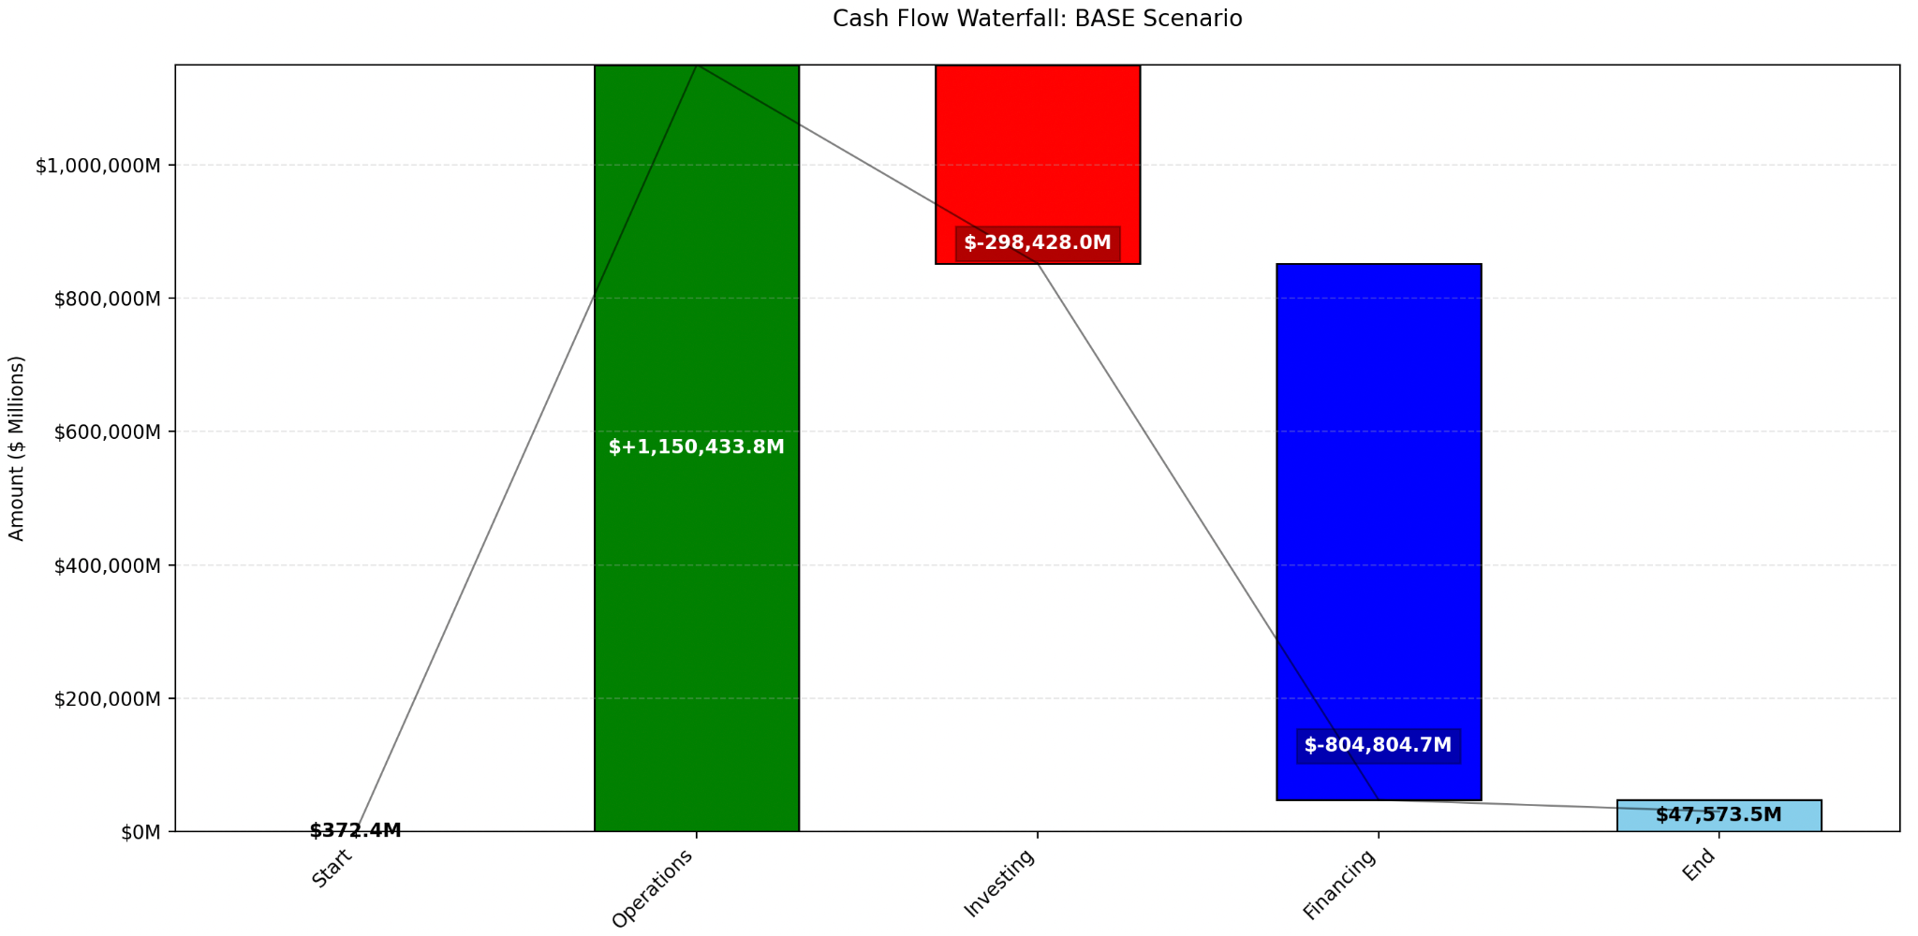
WaterFall (Base Case)

Slide 22
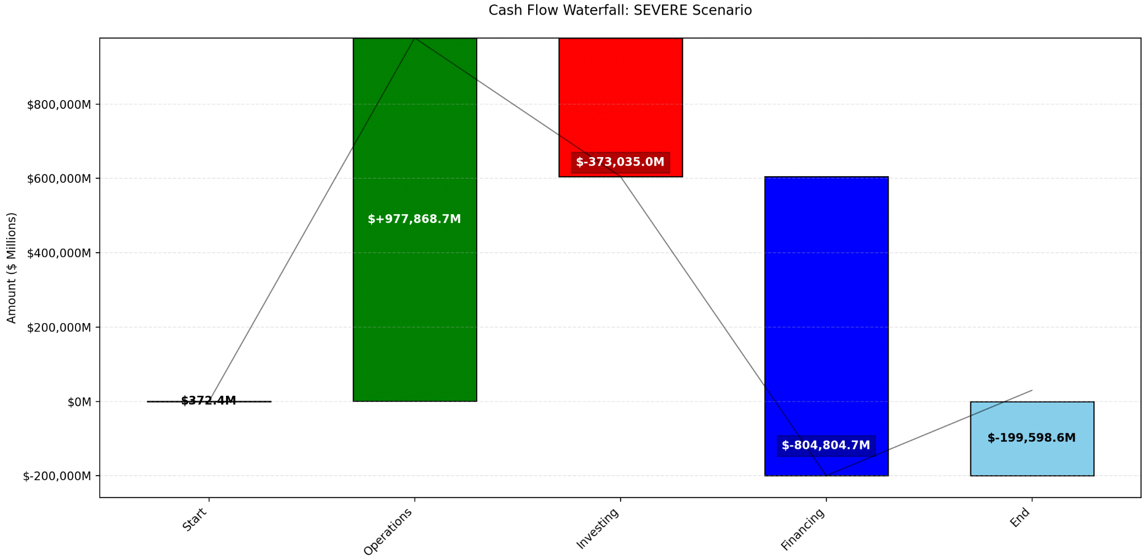
WaterFall
(Serve Case)

Slide 23
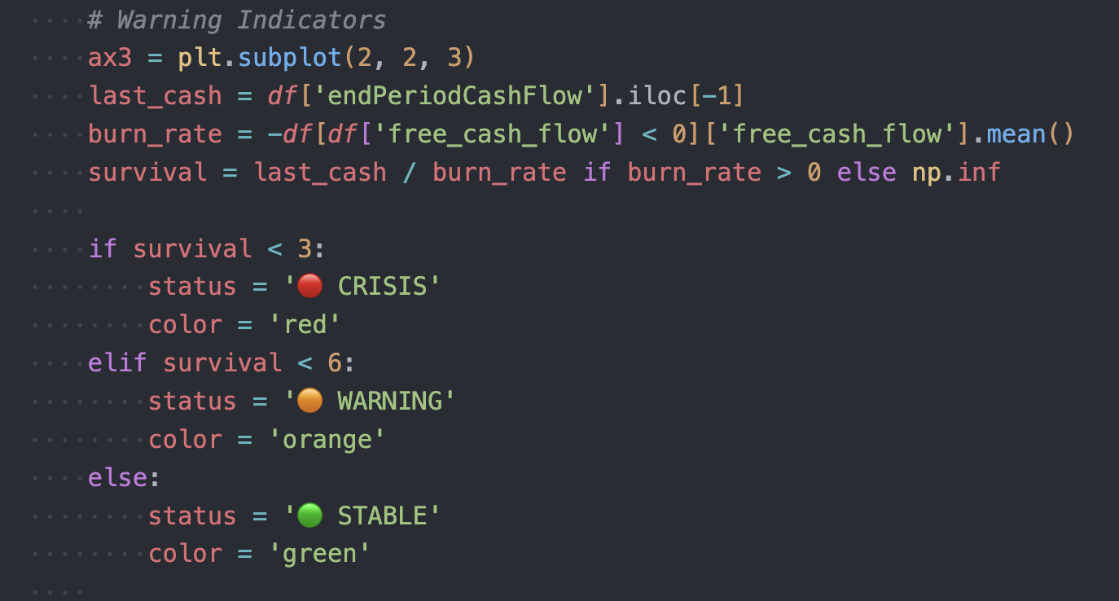
Warning Indicators
survival refers to the number of months of cash runway that the company has left before it runs out of cash.

Slide 24
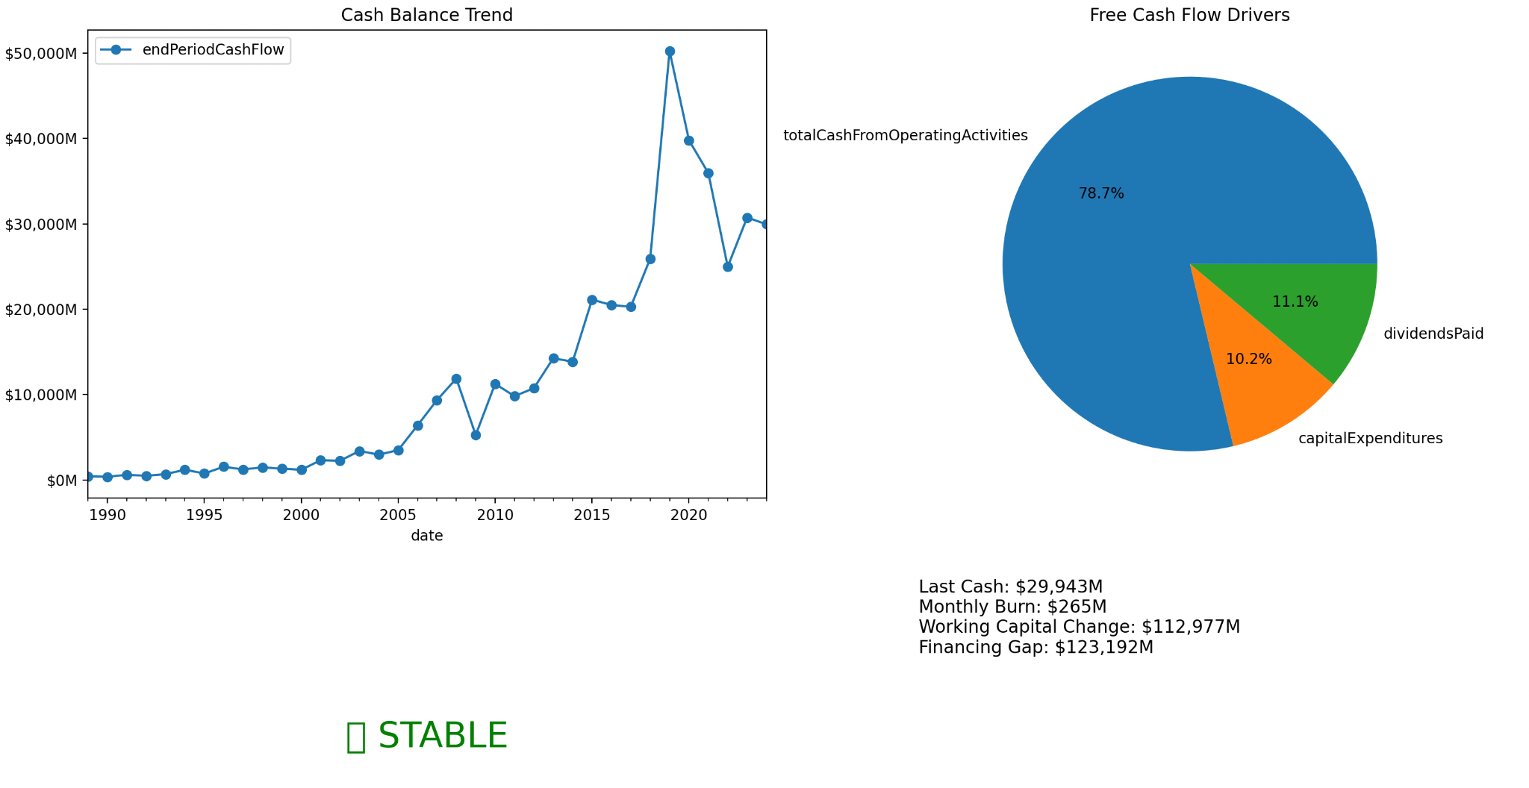
Liquidity Monitoring

Slide 25
LLM Application
Notes:
Our methodology involves selecting appropriate machine learning models, validating their performance, and optimizing model parameters to improve predictions.

Slide 26
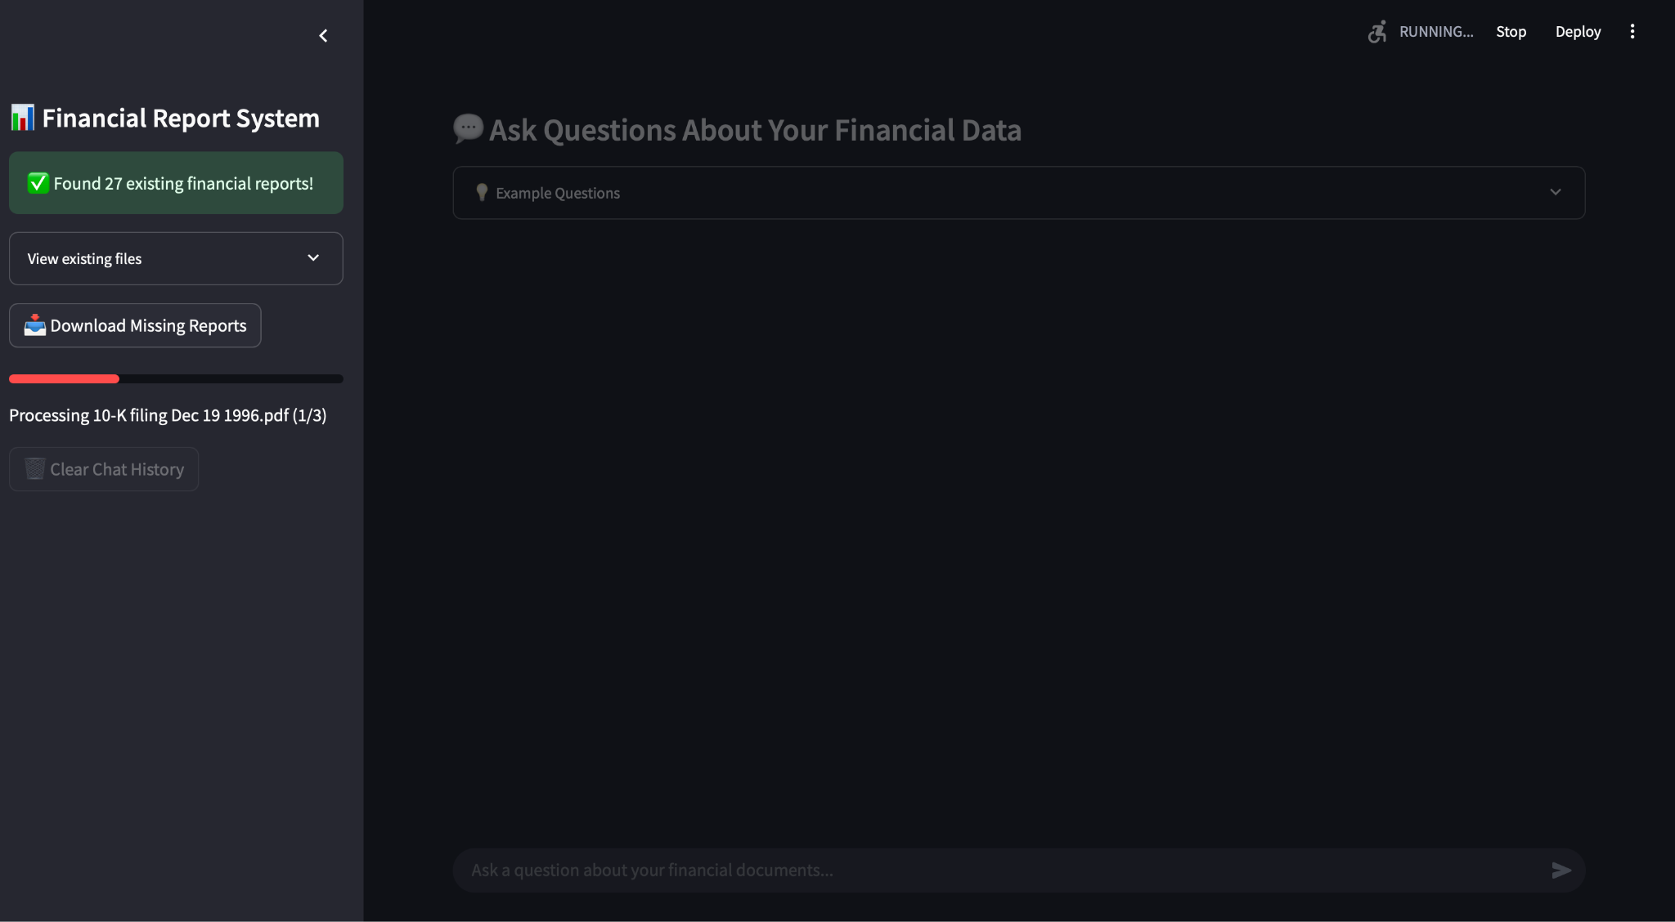
AI ChatBot
Web scraping to download official annual report
save the annual report to a vector database

Slide 27
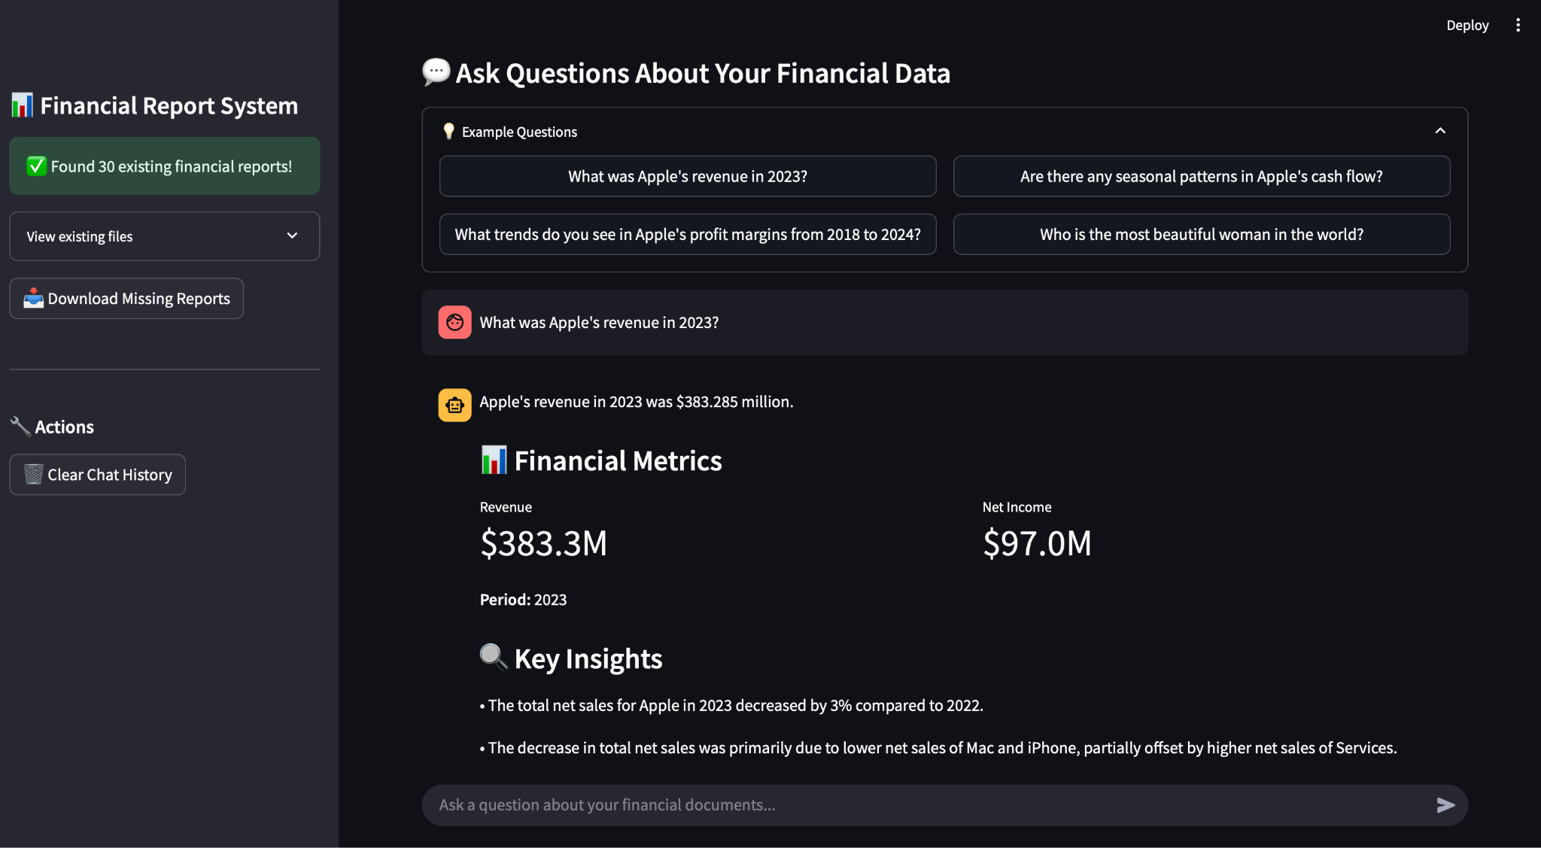
AI ChatBot
LLM for answering questions based on the information in the annual report.
Chat history to maintain context over the conversation, allowing for more coherent and relevant responses.

Slide 28
Challenges and Limitations
Notes:
In this section, we will present the results of our models, evaluate their performance using various metrics, and provide visual comparisons.

Slide 29

Discussion of Challenges Faced During the Project
Limitations of the Approach or Dataset
Dataset Limitations:
Relies on historical Apple financial data; may not generalize to other firms.
Lacks external factors (e.g., market trends, economic indicators).
Model Limitations:
Linear regression assumes linear trends, missing non-linear patterns.
Forecasts (2025–2029) may not account for unforeseen disruptions.
Notes:
We encountered challenges such as data inconsistencies, limited data availability, and the complexity of handling large datasets. These hurdles required creative problem-solving.

Slide 30
Future Work
Notes:
In this section, we will present the results of our models, evaluate their performance using various metrics, and provide visual comparisons.

Slide 31

Future work
Customizable Scenario Analysis Idea: Allow user-defined growth rates and variables via dashboard sliders.
Email/SMS Notifications Idea: Send alerts for cash shortfalls via email or SMS
Sentiment Analysis Idea: Integrate sentiment scores collected from news articles or social media into predictive models
Integration with External Data Sources Idea: Enrich analysis with macroeconomic indicators e.g. GDP, unemployment rates. Pull in live data with APIs.
Notes:
We encountered challenges such as data inconsistencies, limited data availability, and the complexity of handling large datasets. These hurdles required creative problem-solving.

Slide 32
Conclusion
Notes:
In conclusion, this presentation has demonstrated how machine learning can effectively predict customer churn. Through careful analysis of the dataset, preprocessing, and model evaluation, we have provided valuable insights to help businesses implement effective retention strategies.

Slide 33

Reference and Distribution of Work
Reference
EODHD
https://eodhd.com/
Scikit-learn - machine learning in Python
https://scikit-learn.org/stable/
Work Distribution
Dirk – Regression models & PowerPoint
Philip – Data Preprocessing & EDA
Olivia & Carmen – Visualization dashboard (Tableau)
Jacob - Alert systems and cash flow analysis
Teddy - LLM Application - AI Chatbot
Notes:
We utilized a dataset obtained from a reputable source, which includes comprehensive sales records from supermarkets in the designated cities, ensuring data reliability.

